Slide 1
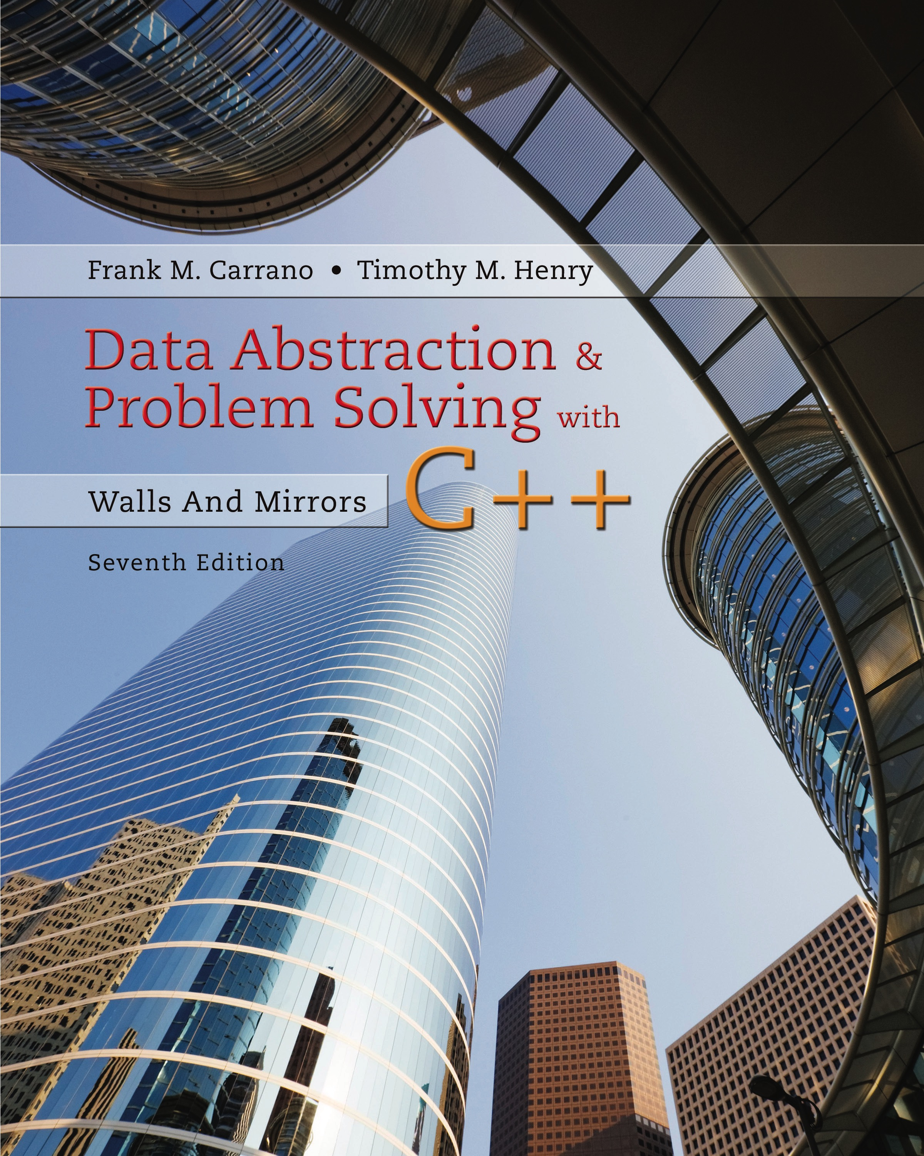
Data Abstraction & Problem Solving with C + +: Walls and Mirrors
Seventh Edition
Chapter 13
Queues and Priority Queues
Copyright © 2017, 2013, 2007 Pearson Education, Inc. All Rights Reserved
Notes:
If this PowerPoint presentation contains mathematical equations, you may need to check that your computer has the following installed:
1) MathType Plugin
2) Math Player (free versions available)
3) NVDA Reader (free versions available)

Slide 2
The A D T Queue (1 of 5)
Like a line of people
First person in line is first person served
New elements of queue enter at its back
Items leave the queue from its front
Called F I F O behavior
First In First Out

Slide 3
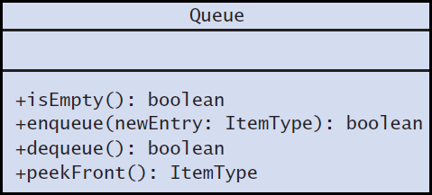
The A D T Queue (2 of 5)
Figure 13-1 U M L diagram for the class Queue

Slide 4
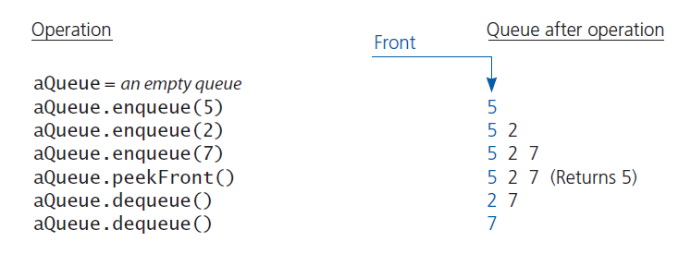
The A D T Queue (3 of 5)
Figure 13-2 Some queue operations

Slide 5
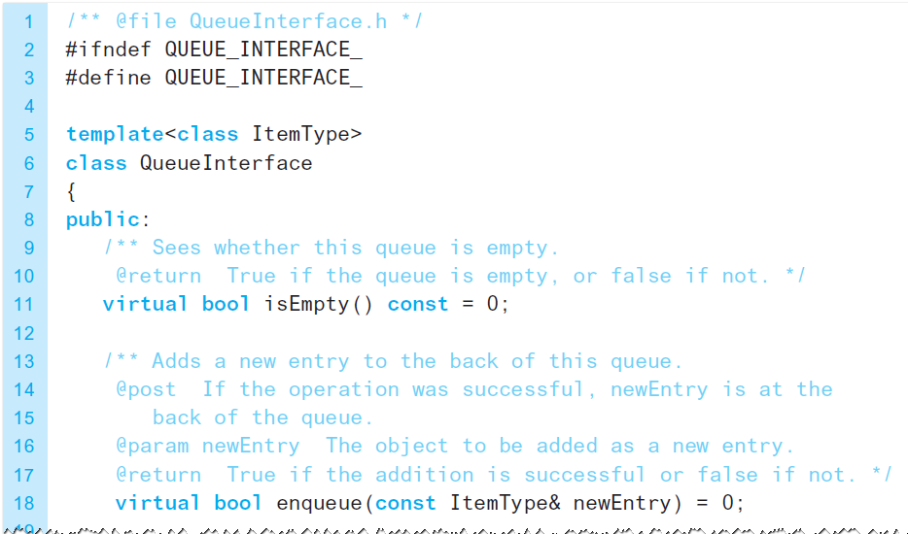
The A D T Queue (4 of 5)
Listing 13-1 A C++ interface for queues

Slide 6
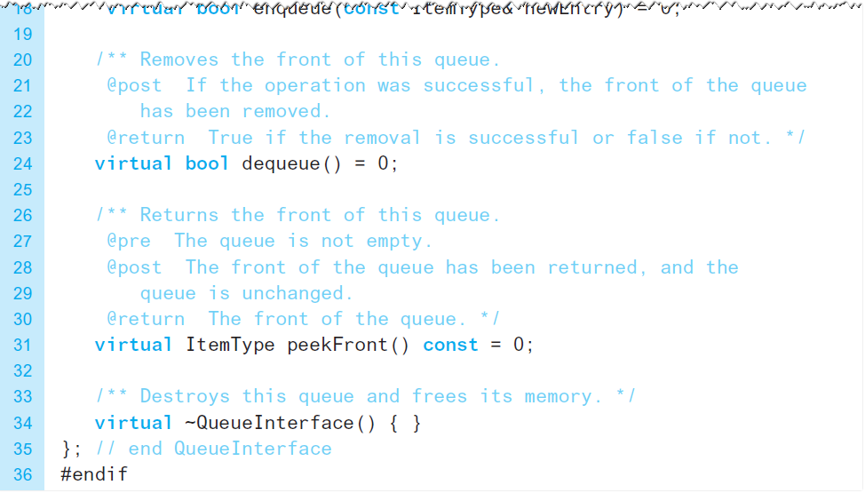
The A D T Queue (5 of 5)
Listing 13-1 [Continued]

Slide 7
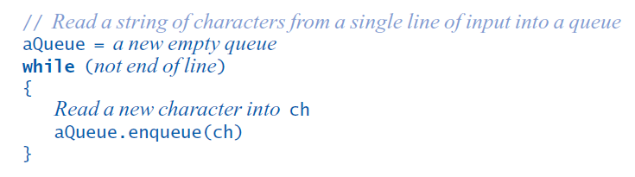
Applications Reading a String of Characters
Pseudocode to read a string of characters into a queue.

Slide 8
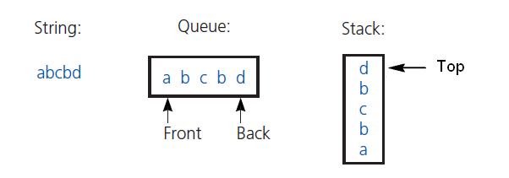
Applications Recognizing a Palindrome
Figure 13-3 The results of inserting the characters a, b, c, b, d into both a queue and a stack
Remove characters from front of queue, top of stack
Compare each pair removed
If all pairs match, string is a palindrome

Slide 9
The A D T Priority Queue (1 of 2)
Organize data by priorities
Example: weekly “to do” list
Priority value
We will say high value ⇨ high priority
Operations
Test for empty
Add to queue in sorted position
Remove/get entry with highest priority

Slide 10
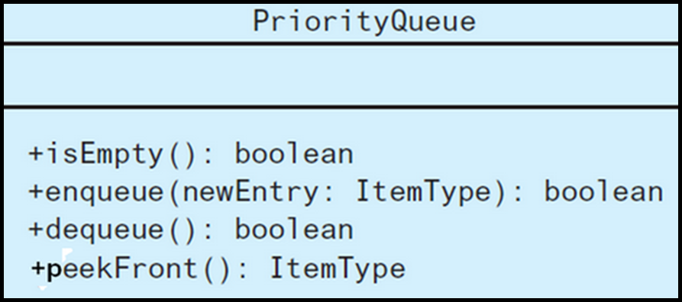
The A D T Priority Queue (2 of 2)
Figure 13-4 U M L diagram for the class PriorityQueue

Slide 11
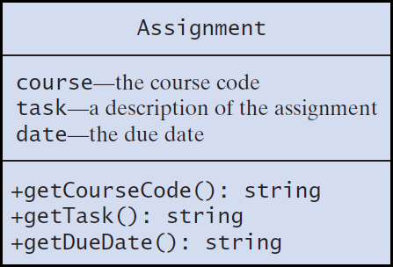
Tracking Your Assignments (1 of 2)
Figure 13-5 U M L diagram for the class Assignment

Slide 12
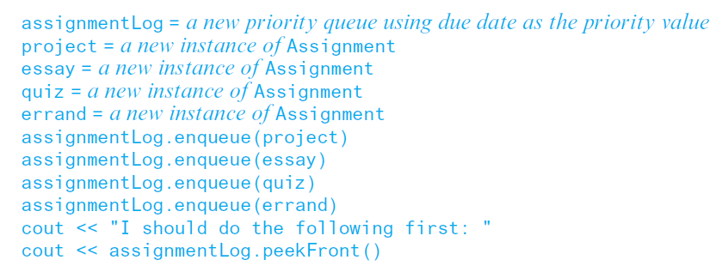
Tracking Your Assignments (2 of 2)
Pseudocode to organize assignments, responsibilities

Slide 13
Application: Simulation (1 of 9)
Simulation models behavior of systems
Problem to solve
Approximate average time bank customer must wait for service from a teller
Decrease in customer wait time with each new teller added

Slide 14
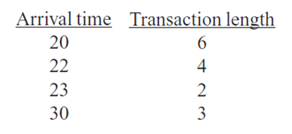
Application: Simulation (2 of 9)
Sample arrival and transaction times

Slide 15
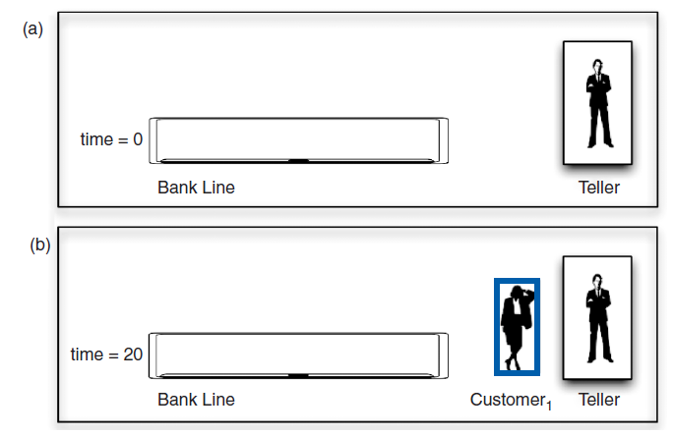
Application: Simulation (3 of 9)
Figure 13-6 A bank line at time (a) 0; (b) 20; (c) 22; (d) 26

Slide 16
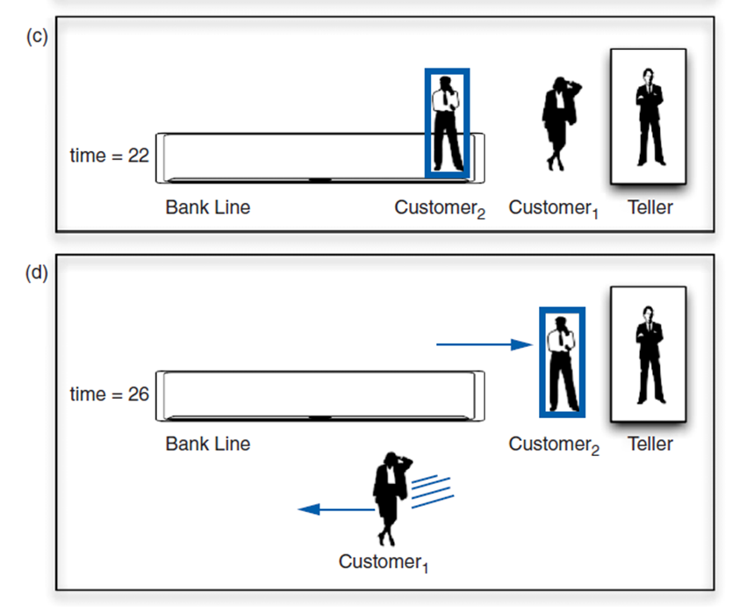
Application: Simulation (4 of 9)
Figure 13-6 [Continued]

Slide 17
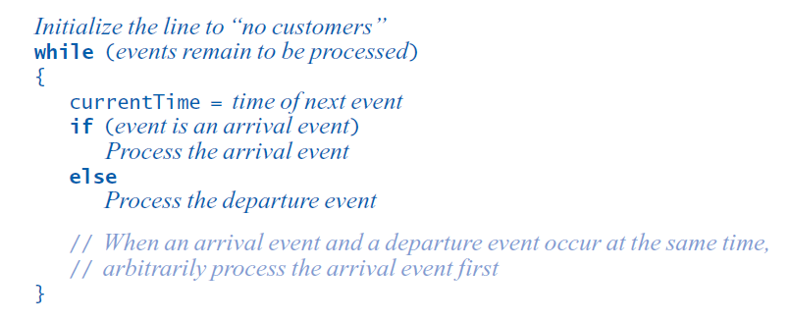
Application: Simulation (5 of 9)
Pseudocode for an event loop

Slide 18
Application: Simulation (6 of 9)
Time-driven simulation
Simulates the ticking of a clock
Event-driven simulation considers
Only the times of certain events,
In this case, arrival-s and departures
Event list contains
All future arrival and departure events

Slide 19
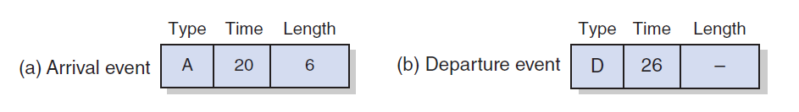
Application: Simulation (7 of 9)
Figure 13-7 A typical instance of (a) an arrival event; (b) a departure event

Slide 20
Application: Simulation (8 of 9)
Two tasks required to process each event
Update the bank line: Add or remove customers.
Update the event queue: Add or remove events.
New customer
Always enters bank line
Served while at the front of the line

Slide 21
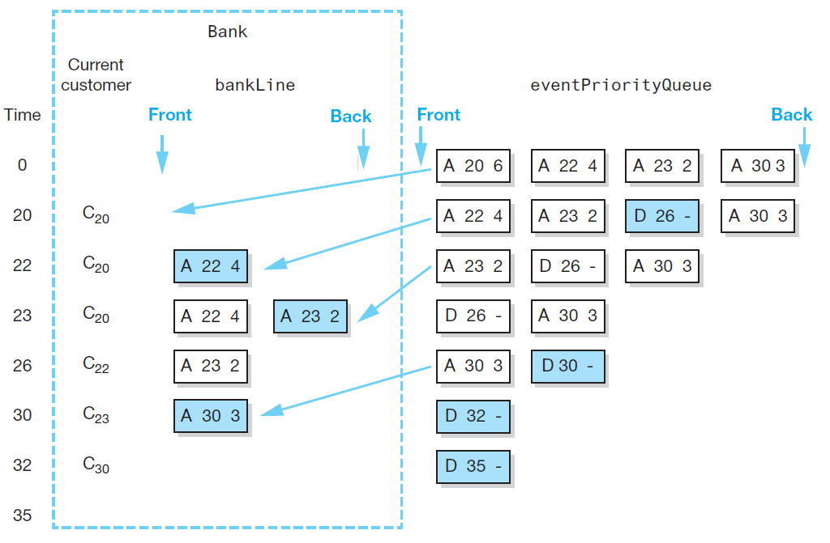
Application: Simulation (9 of 9)
Figure 13-8 A trace of the bank simulation algorithm for the data (20, 6), (22, 4), (23, 2), (30, 3)

Slide 22
Position-Oriented and Value-Oriented A D T s (1 of 3)
Position-oriented A T D s
Stack, list, queue
Value-oriented A D T s
Sorted list

Slide 23
Position-Oriented and Value-Oriented A D T s (2 of 3)
Comparison of stack and queue operations
isEmpty for both
pop and dequeue
peek and peekFront

Slide 24
Position-Oriented and Value-Oriented A D T s (3 of 3)
A D T list operations generalize stack and queue operations
getLength
insert
remove
getEntry

Slide 25

Copyright

